Slide 1
Leconfield Parish Council
& Community Speed Watch Team
--------------------------
Road Safety
&
Traffic Calming Project
14/08/25
-----------------------------------------
ERYC
Lianne Darbinson - Senior Engineer, Traffic Management
Paula Parker - Service Manager - Traffic & Parking
---------------------------------------------------------------

Slide 2
Introductions & welcome
Brief overview .
Key Area’s of concern
  Speeding
  Prevention
    Assets
Road Users
  School Safety
  Parking
  St Catherines Church
    Provision for a layby
  Play Park Entrance

Slide 3
Hot Spots
Main Street
  Speeding into & exiting the village
  Pedestrian Crossing
  National Speed Limit ( 60mph) / 50mph
Miles Lane /Old Rd Junction
  Speeding into & exiting the village
  Children's play area
  Commuting speeder’s
Arram Rd/ Grange Rd
  Speeding into the village National Speed limit
  LPS ( drop off / pick up)
  Grange Rd Pedestrians at school pick up& drop off times

Slide 4
Improving Road Safety in Leconfield /Arram & Scorborough :
A Focus on Key Local Roads /Executive Summary
The intent of this meeting is to highlight the concerns and make recommendations to enhance road safety in our parish, particularly around high-risk or sensitive areas such as schools, parks, and village junctions. Specific attention is given to Main Street A164 , Arram Road, Grange Rd , Miles Lane, Harthill Ave & St Catherine’s Ave .
Consideration should be given to apply clearer road markings at the cul-de-sac junctions , speed reduction measures, such as buffer zones at the entrance to the village via the A164 both from Driffield ( NSL ) Limit/ Beverley ( 50MP)
Our parish roads serve not only as transport routes but as community spaces used by families, school children, and elderly residents.
Increasing traffic volume and speeding have raised safety concerns, especially in areas frequented by vulnerable road users. Lec PC seeks to highlight these issues and propose practical improvements.

Slide 5
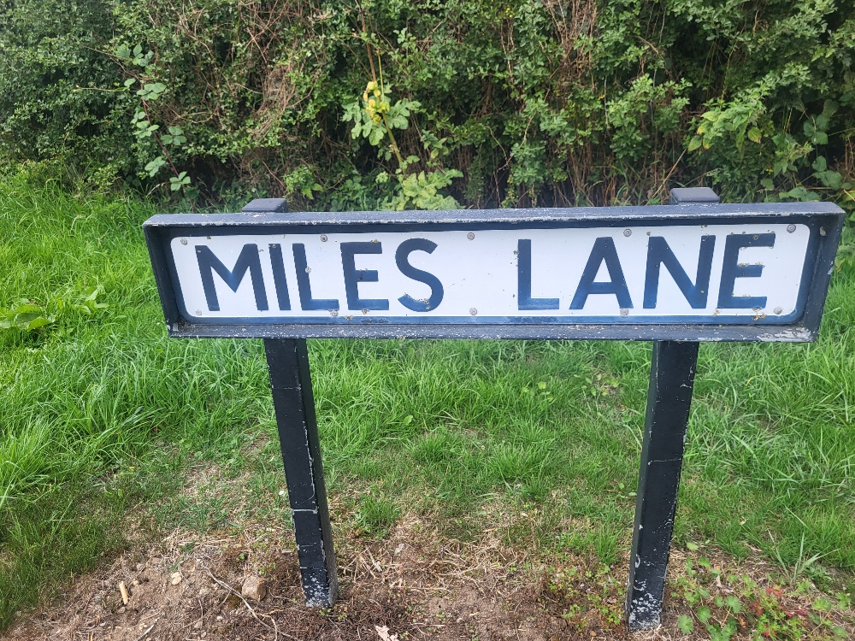
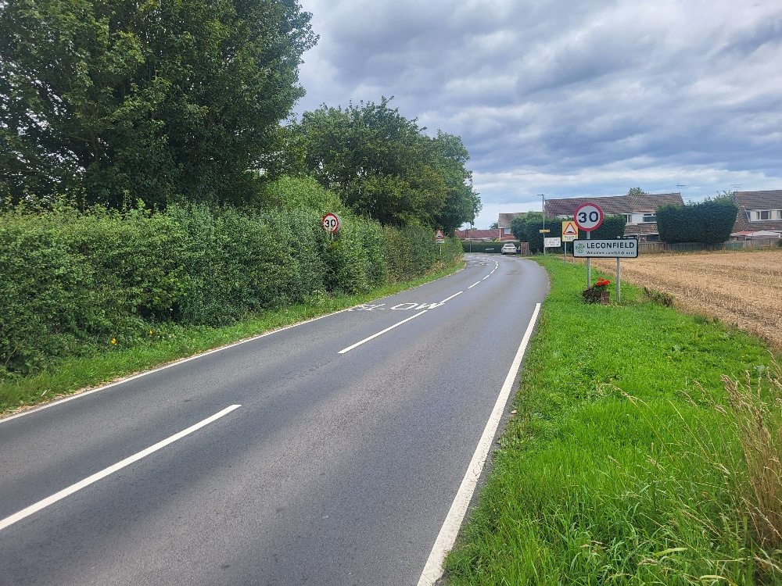
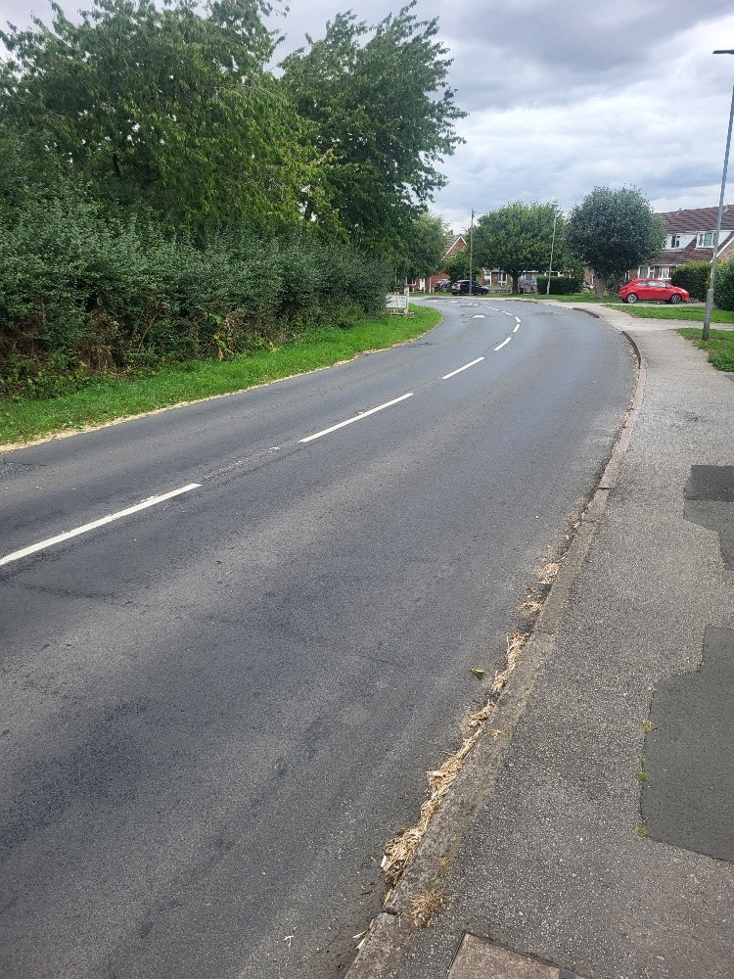
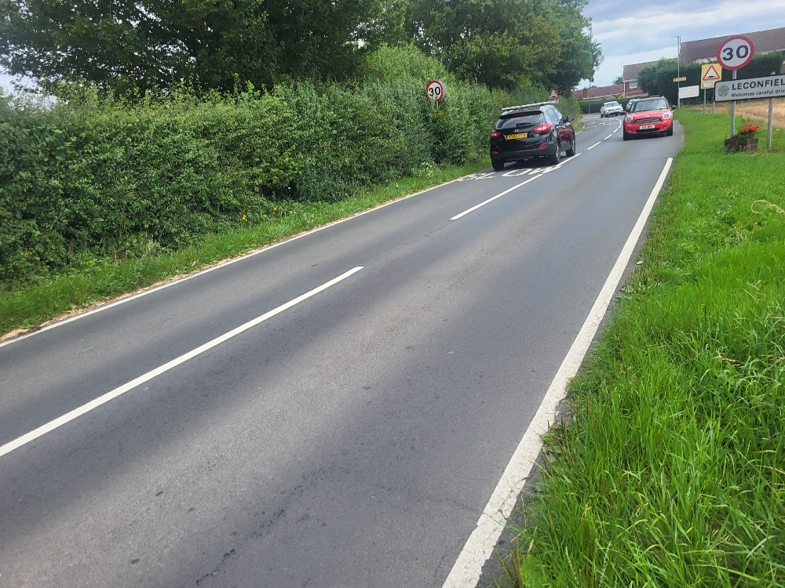
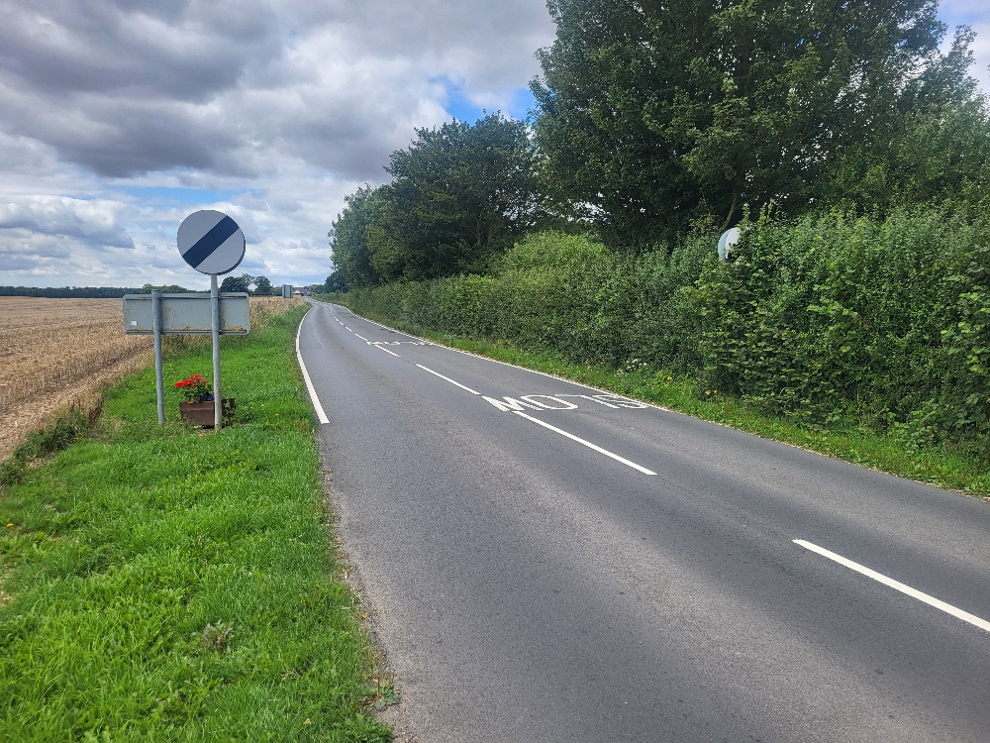
Miles Lane /from Cherry
Entry into Lec form Cherry 60mph … 30mph
Other dangers Children's Play Park on restricted view
pedestrian crossing place
Lack of enforcement to 30mph
No speed calming /buffer zone
Volume of traffic
Leaving Lec speed encouraged accelerating to 60 MPH.

Slide 6
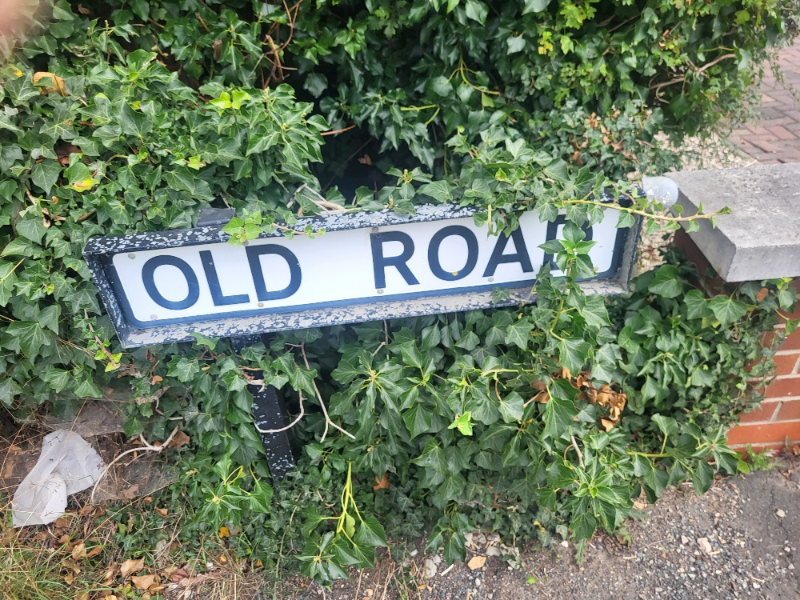
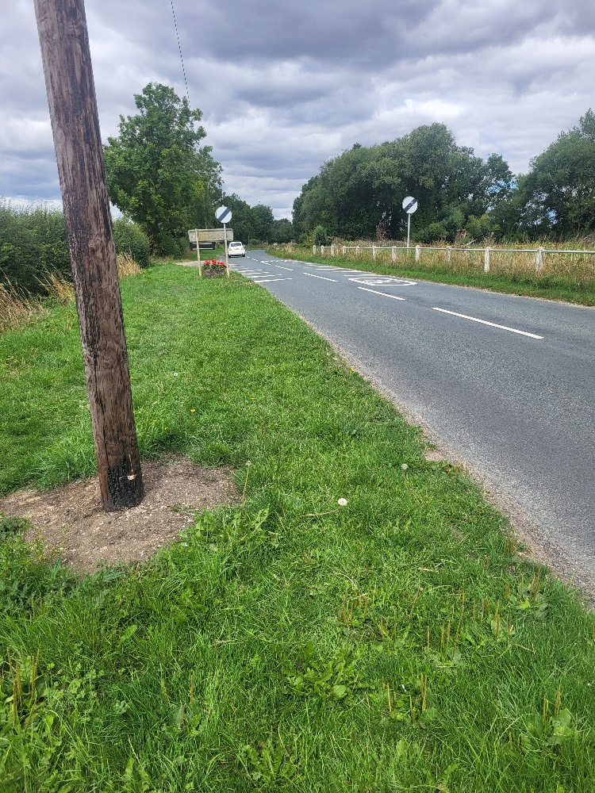
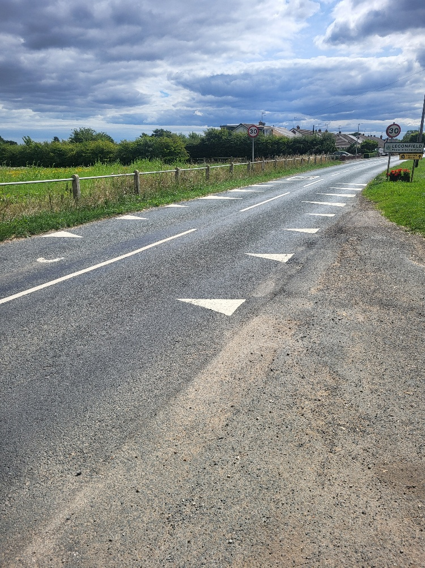
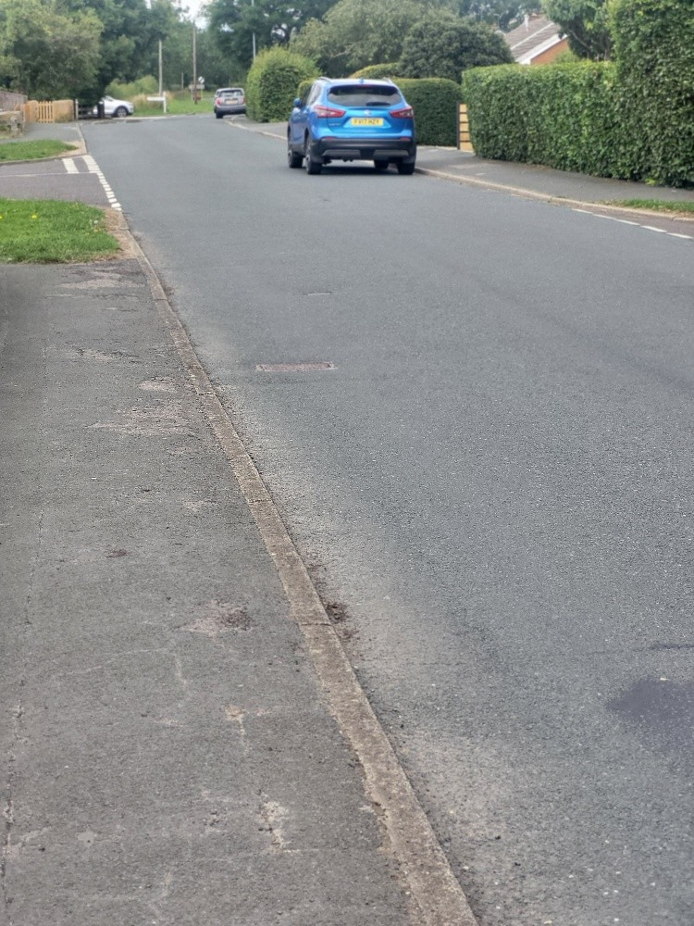
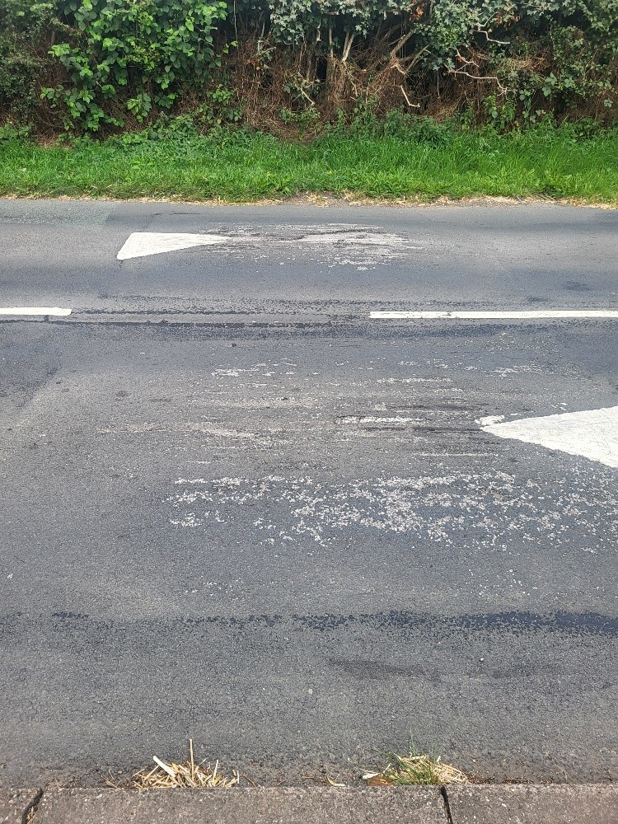
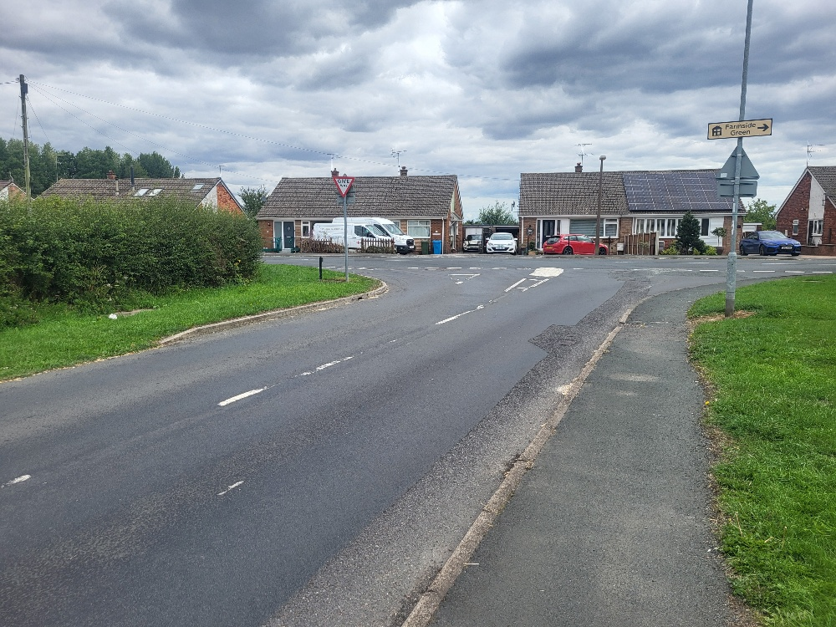
Old Rd into Miles Lane ~ from Driffield
60 MPH Speed Limit
Reducing to 30mph
& reversed
Old Rd , 30mph , no speed reduction enforcement
Degraded over time
Speed cushions

Slide 7
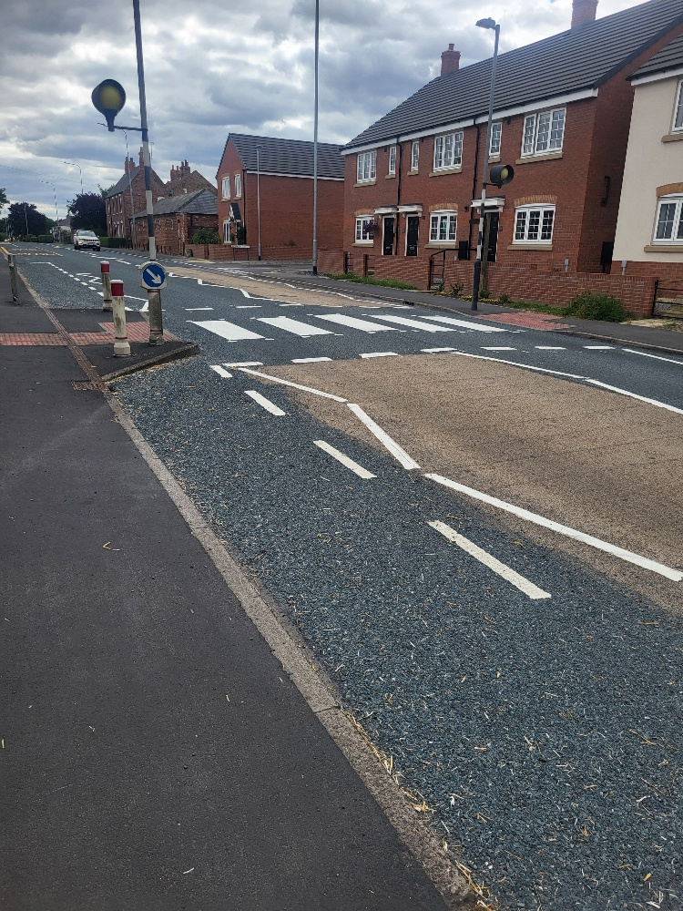
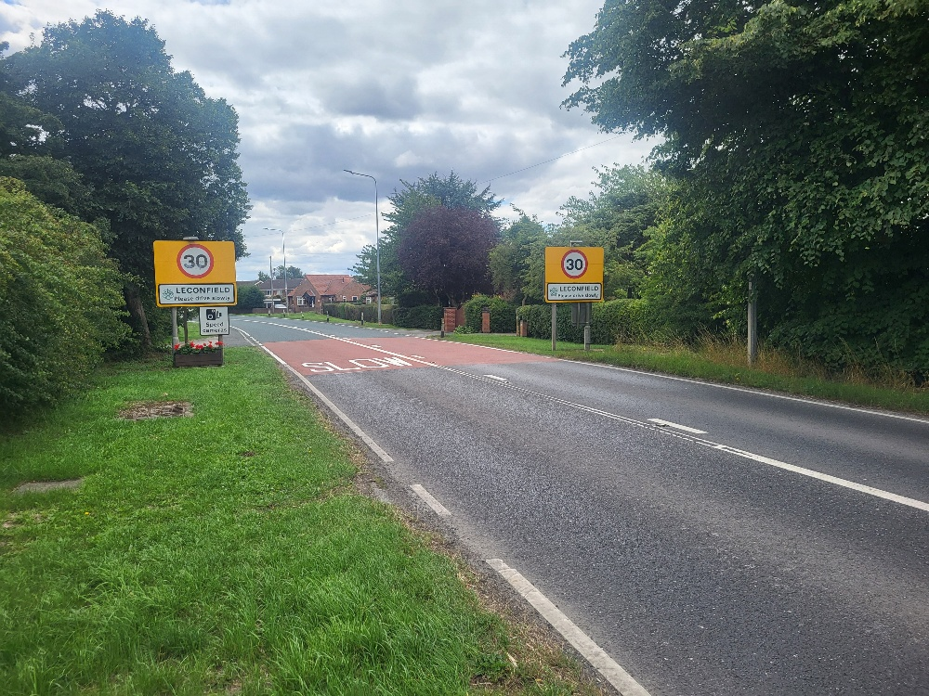
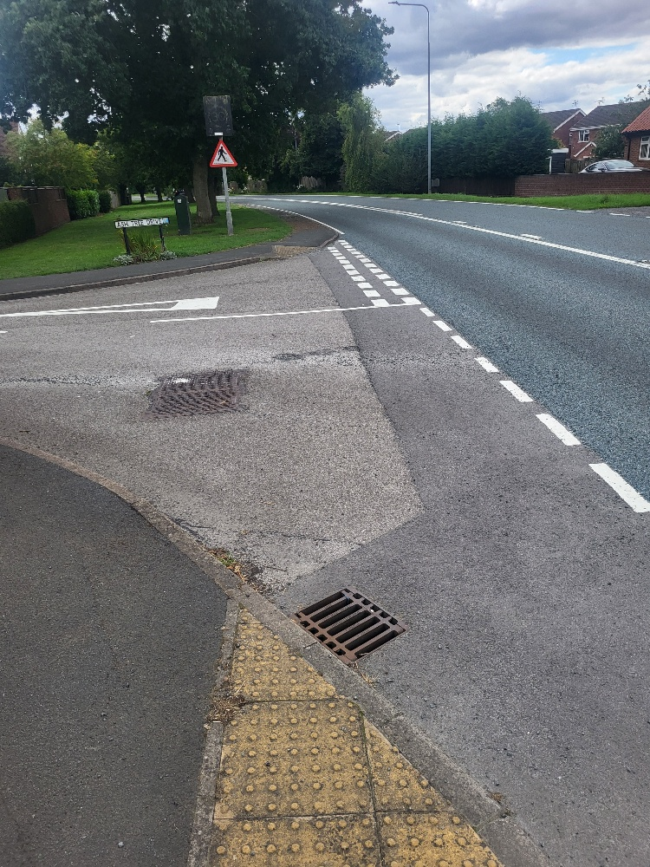
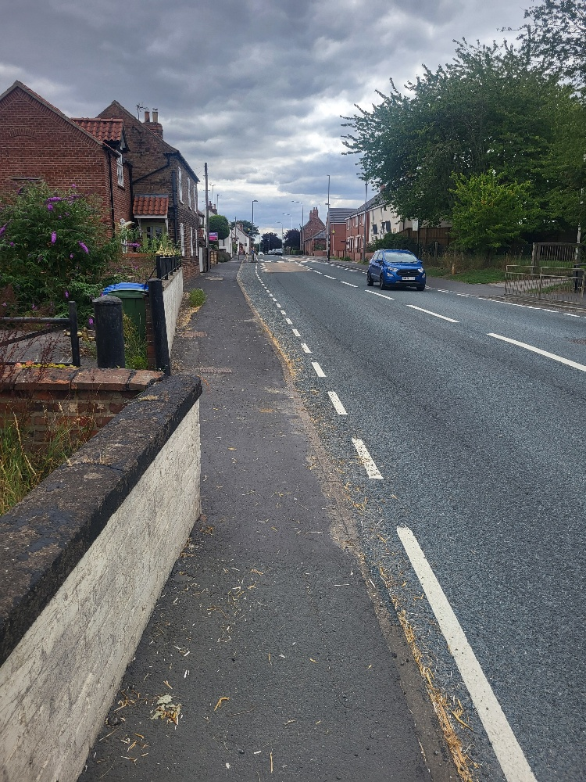
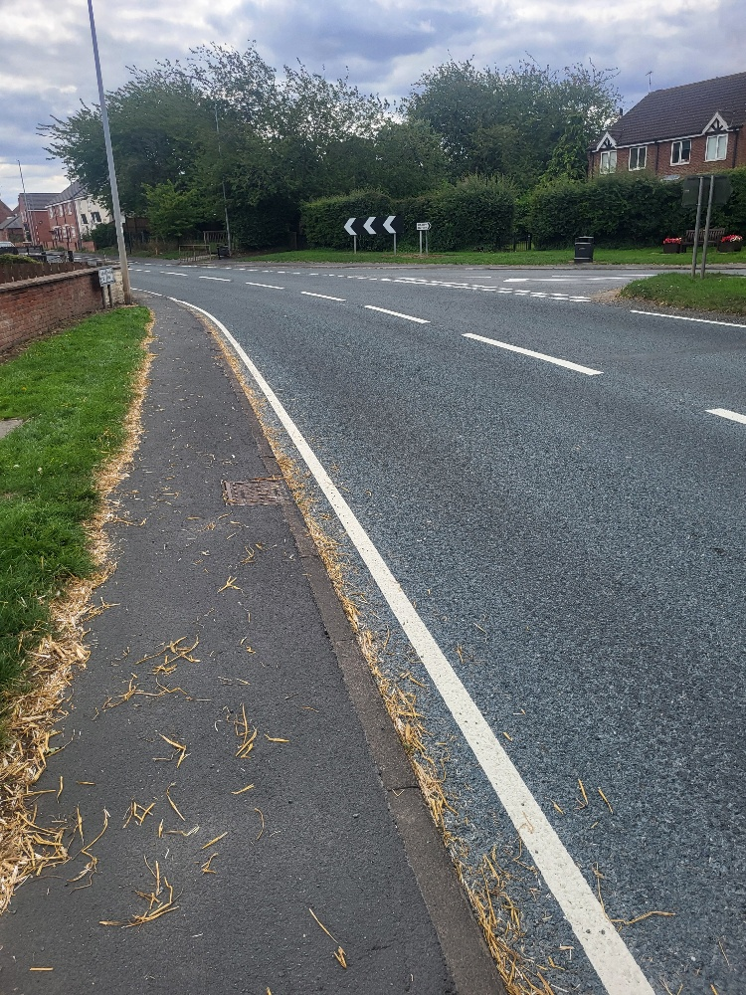
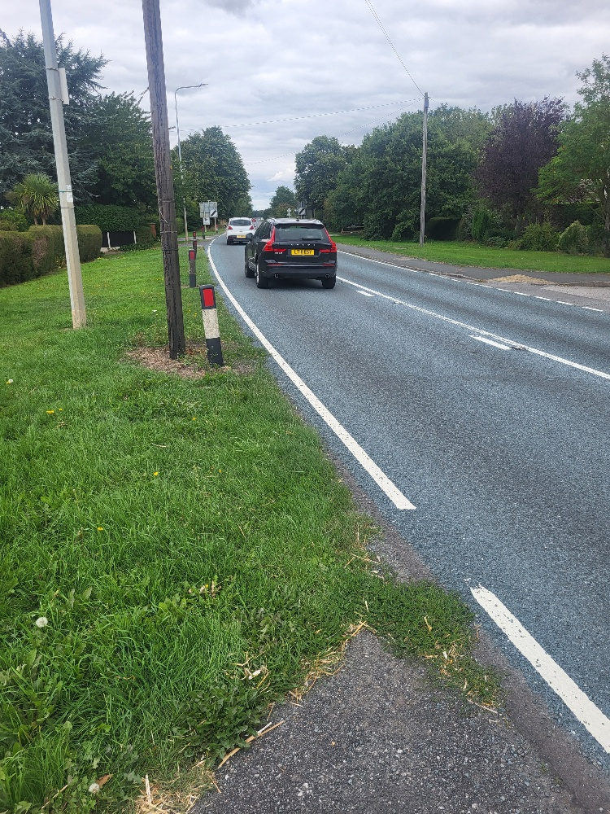
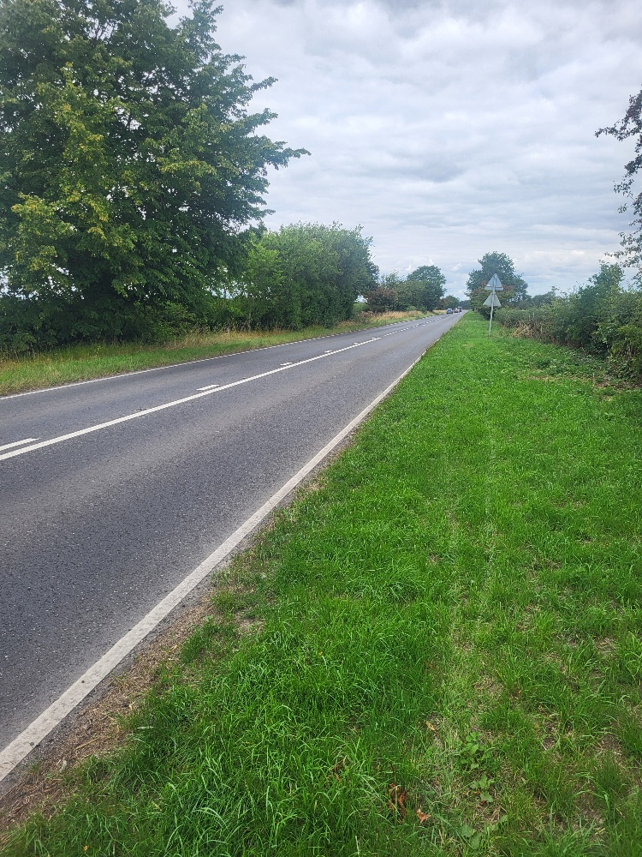

Main Street Driffield entry/exit ..
Speed sign
to Late !
60mph ~ 30MPH
Pedestrians / school kids / & junctions
30mph ~ 60 mph

Slide 8
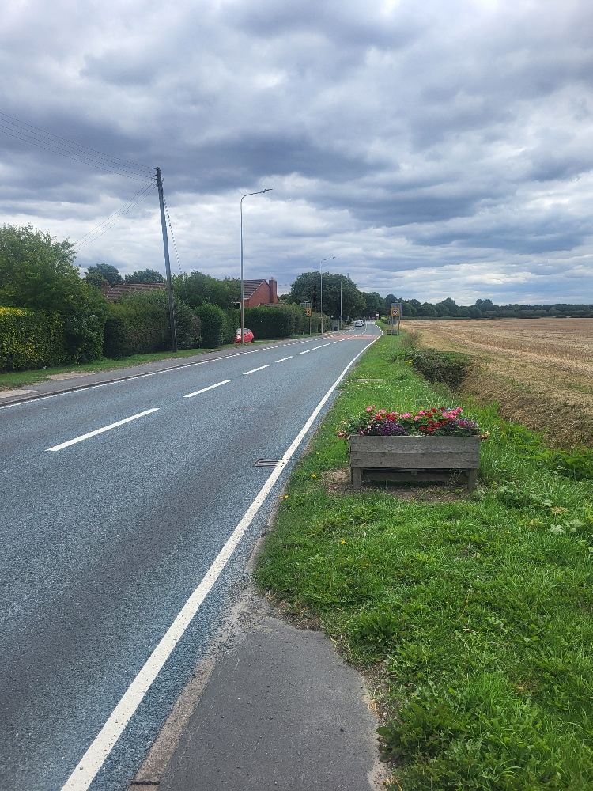
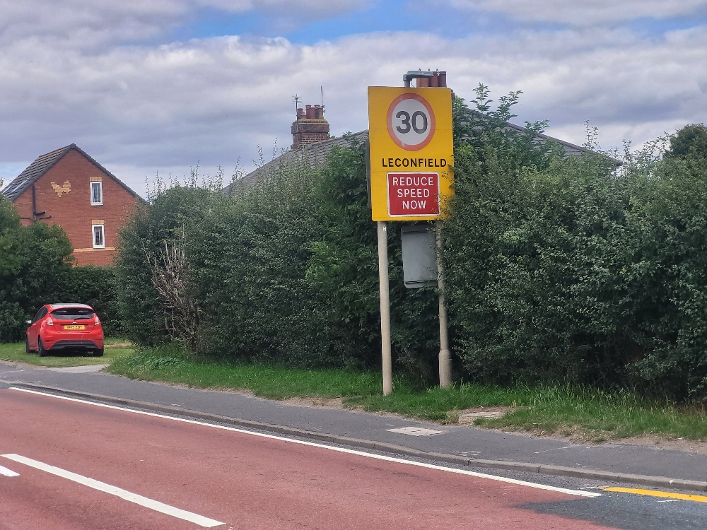
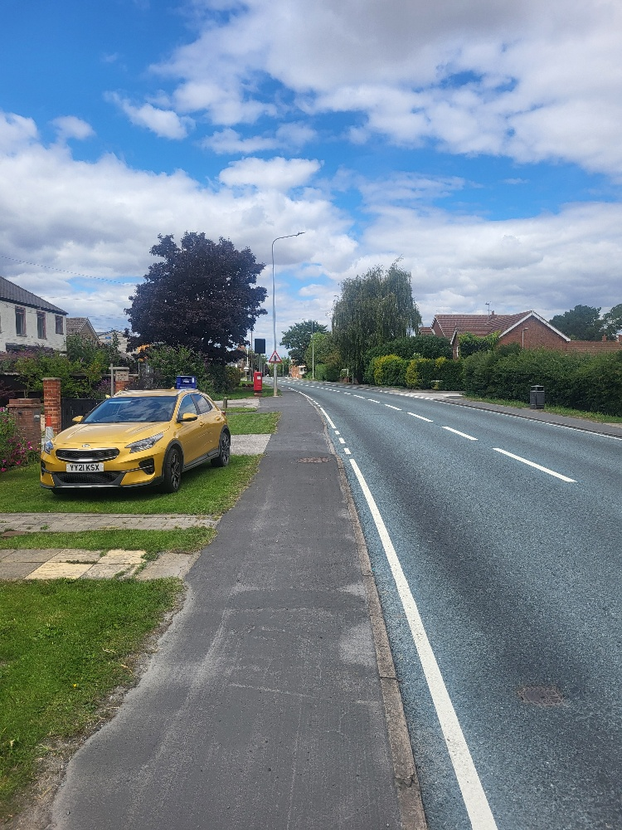
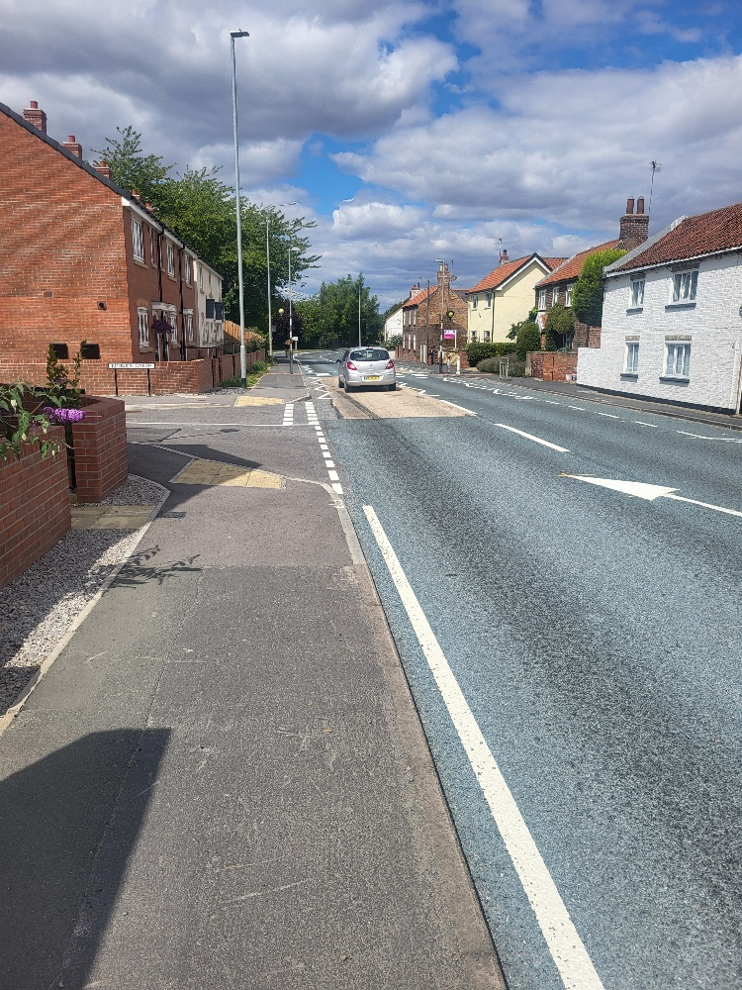
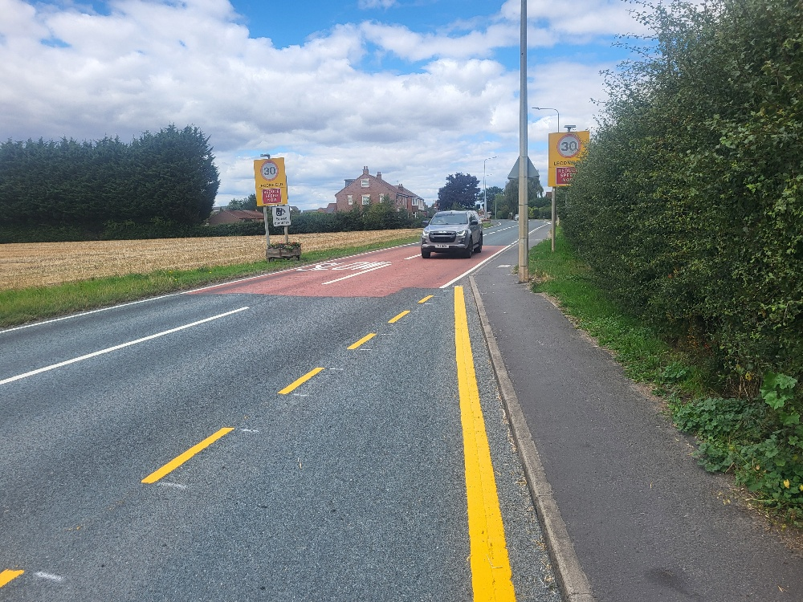
Main Street – Beverley entry / exit
Only crossing available
Heavy pedestrian usage
Approaching Lec @
50mph
Fast straight in
the built up area
Speed alert beyond the
Mandatory speed notice
30mph

Slide 9
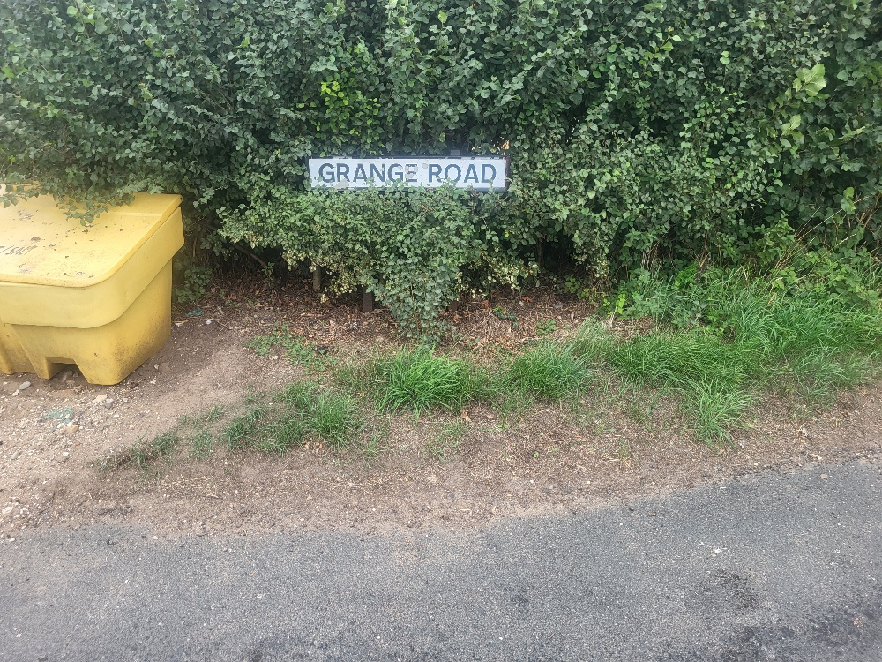
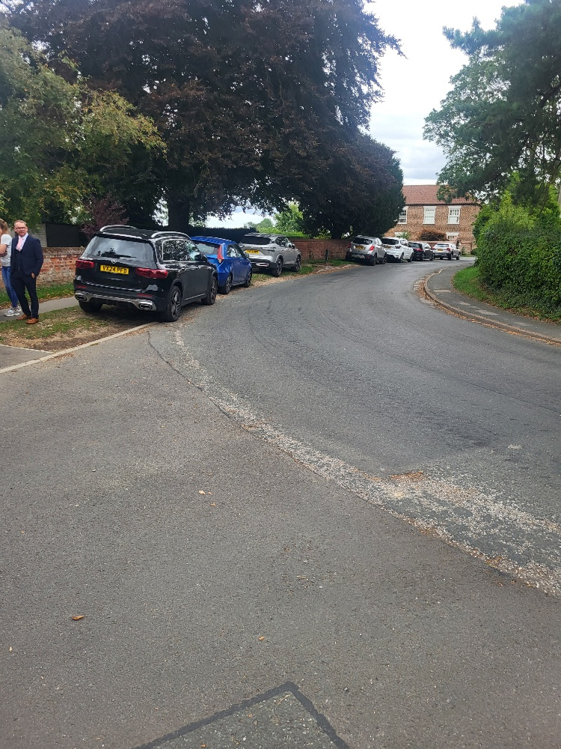
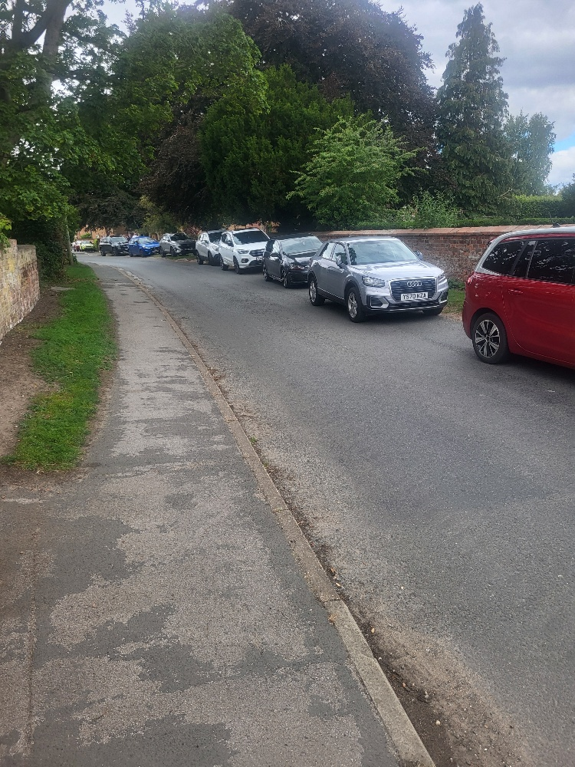
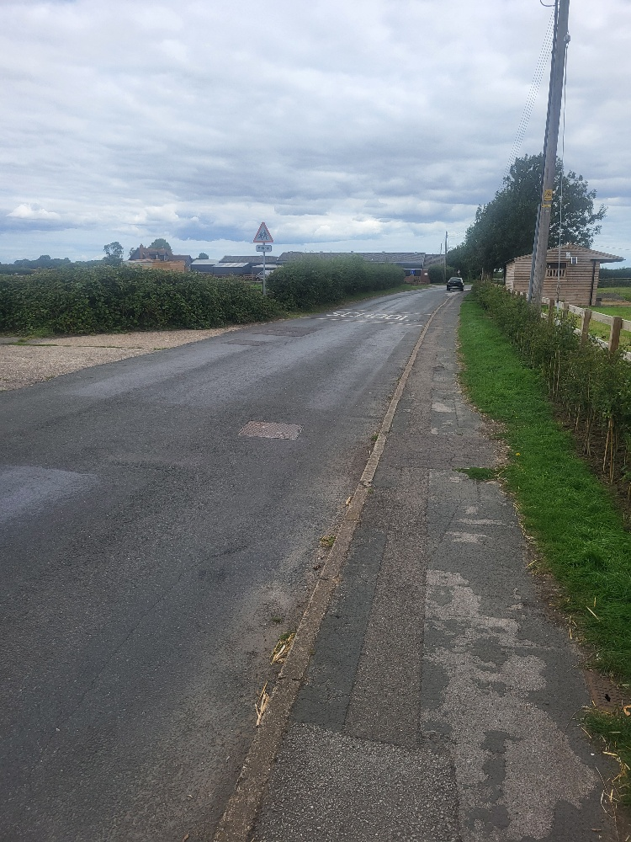
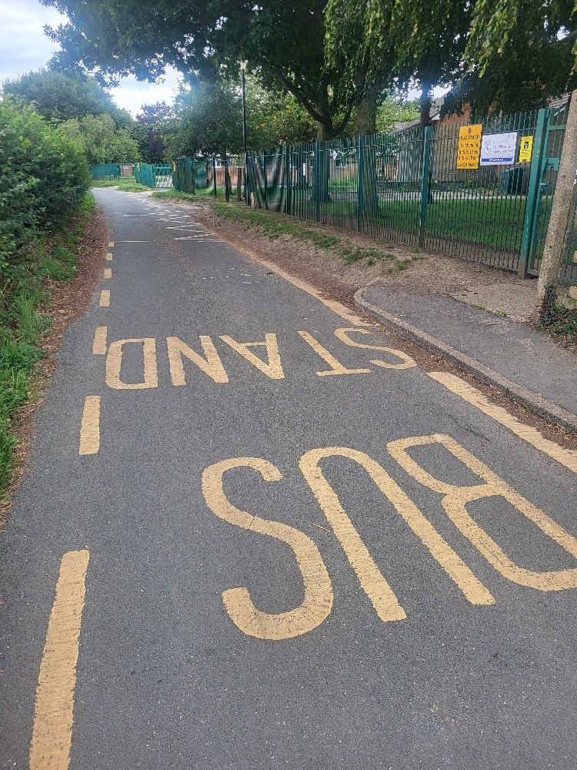
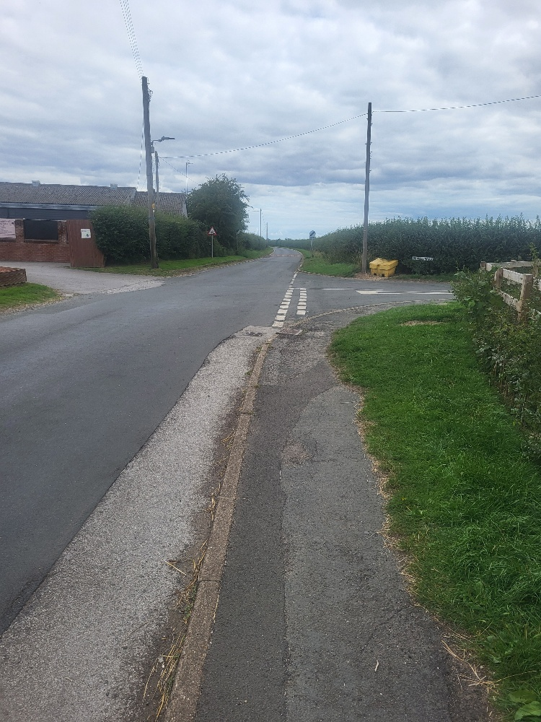
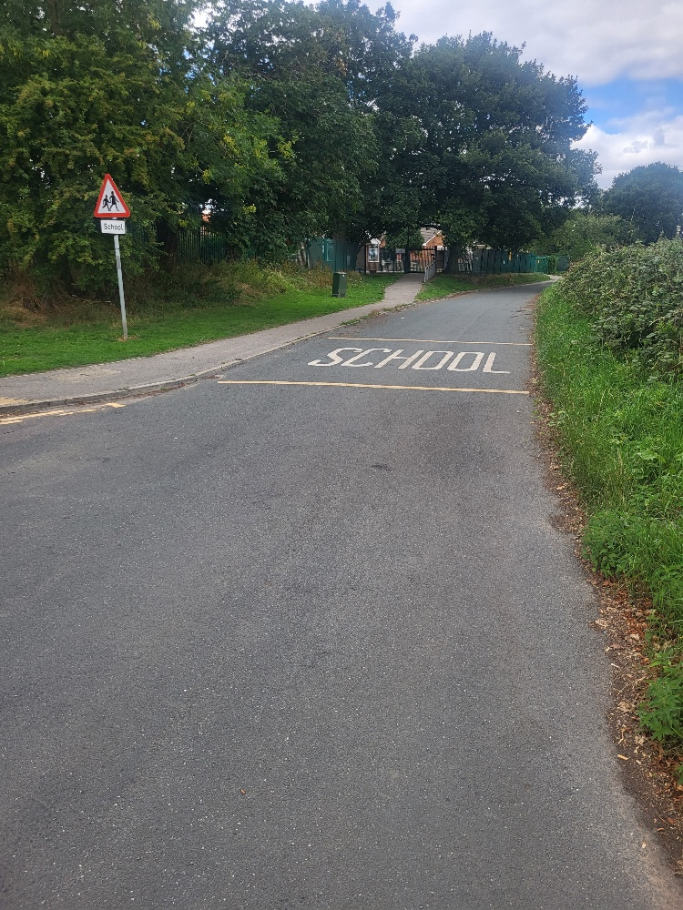
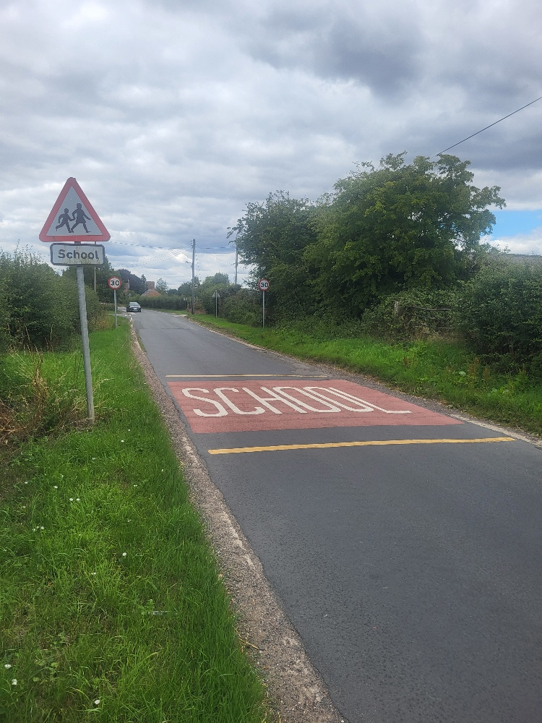
Arram Rd ~ Grange Rd ( School)
School drop off zone
Parking Issues outside
St Catherines Church
​
Proposed Solution –
Establish a Layby
Outside school 30mph !!
No traffic restrictions
Entry /exit to Arram 60MPH

Slide 10
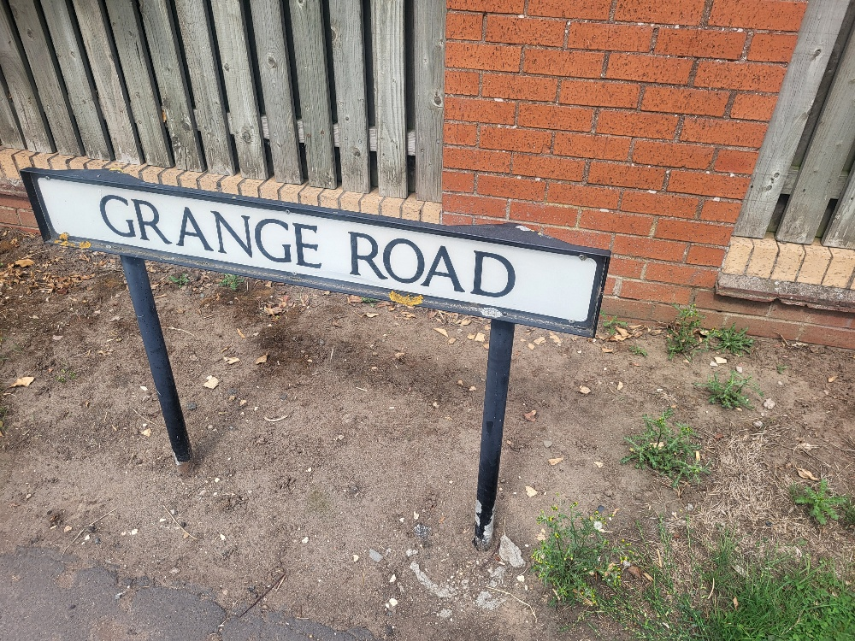
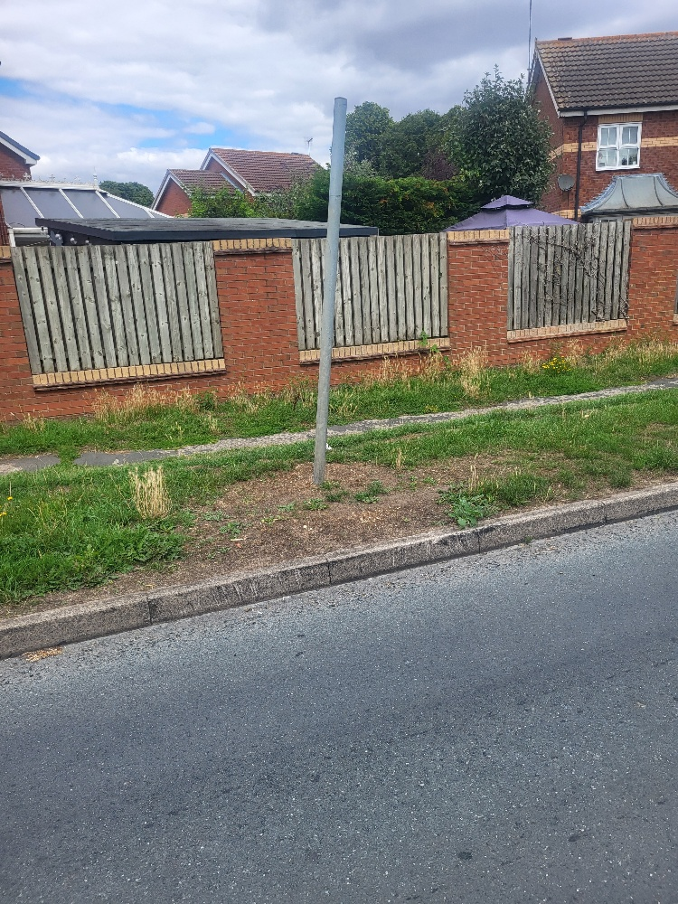
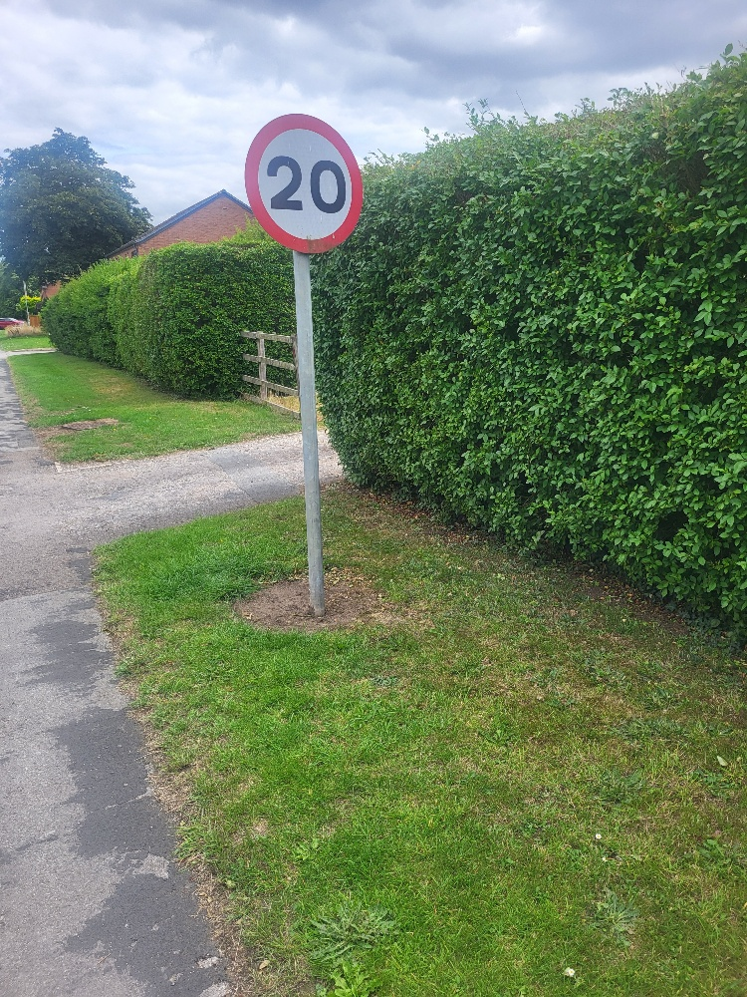
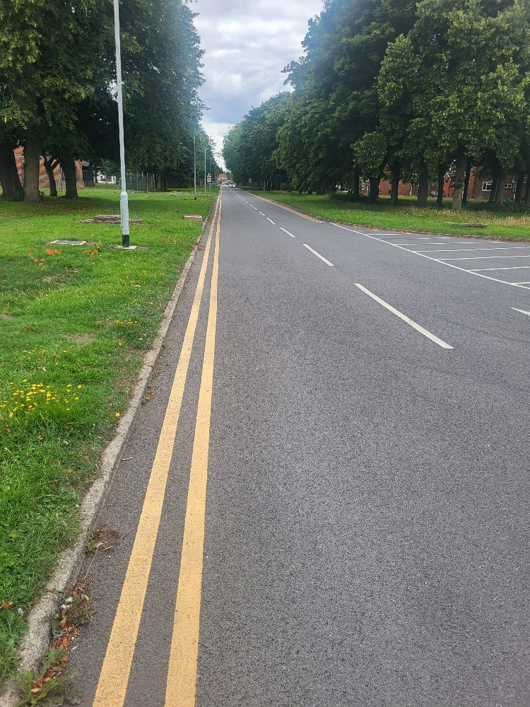
Grange Rd /DST
Signage for 20mph with repeaters / Historically Private road re-instate 30mph
Give protection to school area / traffic restrictions / Mandatory 20mph with correct signage

Slide 11
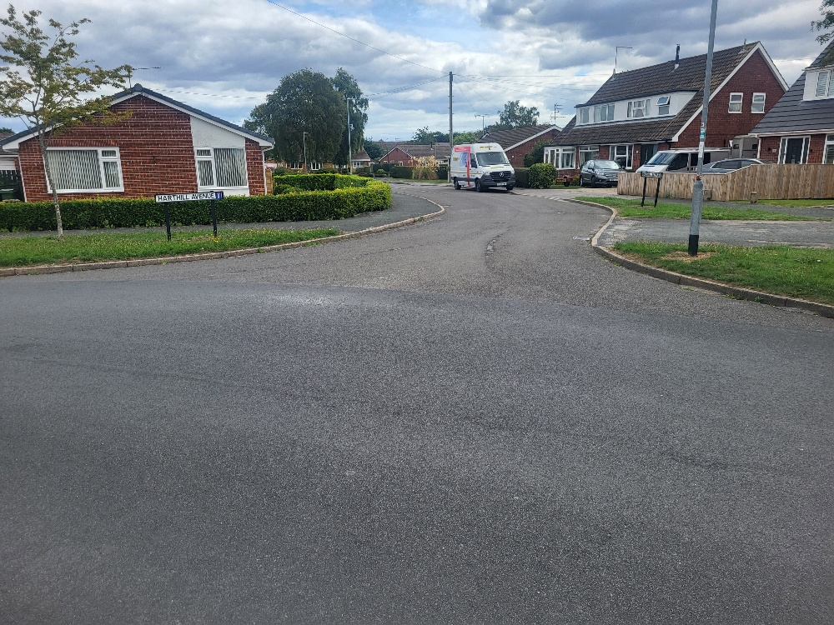
Residential Side Roads
No lines at busy junctions /no speed calming measures

